Slide 1
Information to the annual report on the activities of JSC "MRPGC" on provision of electric power transmission and distribution services to consumers and other interested parties
April, 2017

Slide 2
Execution of the Investment Program of JSC "MRPGC" for 2016 approved by the Department of the Committee for the Regulation of Natural Monopolies and the Protection of Competition in Mangistau Region
No. | Name of the project | Volume | The cost of the project, million. KZT
1 | Construction of power transmission line-220kV Aktau-Karazhanbas with autotransformer 1x125MVA at Node Distribution Substation "Karazhanbas" | 198,6/1 | 6 546,8
2 | Construction of a regional dispatch center | 1 | 688.9
3 | Implementation of the project on Automatic system for commercial accounting of power consumption at 6-10 / 0.4kV of JSC "MRPGC" with the introduction of telemechanics and telemetry | 1/18692 | 226.2
4 | Modernization of a 6kV switchgear at a 110 / 6kV "steam treatment" substation with the replacement of a closed switchgear-6kV with a package outdoor switchgear of 6kV | 1./25 | 168.2
5 | Reconstruction of the equipment of outdoor switchgear-35kV, 110kV with replacement of separator — shorting device-110kV and installation of 35kV reclosers at substation 110/35 / 6kV "East Zhetybay" | 1./7 | 254.4
6 | Modernization (reconstruction) of outdoor switchgear 35 kV at substation 110/35/6kV substation "Depression" and substation "Plateau" | 2./15 | 512.2
7 | Replacing of the separator — shorting device-110 kV with gas-insulated circuit breakers at substation 110/6 kV Karazhanbas-2 |  | 5.2
8 | Modernization (reconstruction) of the equipment of outdoor switch-gear -110kV to substation 220/110 / 10kV "Uzen" No. of cells 1,2,7,8,11,12,15,16,24,25,26,27,28,29, 30,31,32 | 17 | 112.2
9 | Modernization (reconstruction) of the equipment of outdoor switch-gear -35, 110 and switchgear -6kV substation 110/35 / 6kV of "Gorodskaya" | 1./7 | 306
10 | Modernization (reconstruction) of the equipment of outdoor switch-gear -110kV and closed distribution device-6kV substation 110 / 6-6kV "Industrial Zone" |  | 43.5
11 | Replacing outdoor switchgear-6kV complete switchgear at Karazhanbas-2 110 / 6kV substation | 1./18 | 227.6
12 | Modernization (reconstruction) of the equipment of outdoor switchgear-35kV substation 35 / 6kV "Block-type pumping station-2,3,4,5", Tasbulat, Beket-Ata, Akkudyk, Akzhigit |  | 201.9
13 | Other projects |  | 31.1
14 | Technical re-equipment |  | 166.7
 | The total amount of investment projects is |  | 9 491

Slide 3
Key financial and economic performance indicators of JSC "MRPGC" for 2016
In thousands of Kazakhstan KZT | Remarks | 2016 | 2015
Revenue | 17 | 10,421,456 | 9,052,792
Cost of sales | 18 | (6,800,201) | (6,272,497)
Gross profit |  | 3,621,255 | 2,780,295
General and administrative expenses | 19 | (1,002,735) | (788,964)
Sales Costs | 20 | (103,751) | (110,264)
Net foreign exchange gain |  | 5.728 | 2
Other income, net | 21 | 85.326 | 20.164
Decrease in value of fixed assets as a result of revaluation | 7 | - | (8,981,176)
Operating profit / (loss) |  | 2,605,823 | (7,079,943)
Financial income | 22 | 140.129 | 99.681
Financial expenses | 23 | (361,290) | (1,012,782)
Profit / (Loss) before tax |  | 2,384,662 | (7,993,044)
(Expenses) / Income of tax savings | 25 | (543,767) | 1,576,278
Profit / (Loss) for the year |  | 1,840,895 | (6,416,766)
Revaluation of fixed assets |  | - | 8,762,114
The effect of deferred income tax on the revaluation reserve of fixed assets | 25 | - | (1,752,423)
Total comprehensive income for the year |  | 1,840,895 | 592.925

Slide 4
Production figures for 2016, including the volume of electricity transmission
Name | Unit | 2015 | 2016 |  |  |  | 2016/
 |  |  |  |  |  |  | 2015
 |  | fact | plan | fact | off | % | %
Power transmission | million kWh | 2 518 | 2 517 | 2 490 | - 26 | 99% | 99%
Volume of electricity sales | million kW
 | million kWh
 | million kWh
Losses | % | 7.07 | 8.23 | 6.89 | - 1,34 | 84% | 97%
Regulatory | % | 7.07 | 8.23 | 6.89 | - 1,34 | 84% | 97%
excess standard | %
Average selling rates | KZT / kWh | 3.57 | 4.11 | 4.16 | 0.05 | 101% | 117%

Slide 5
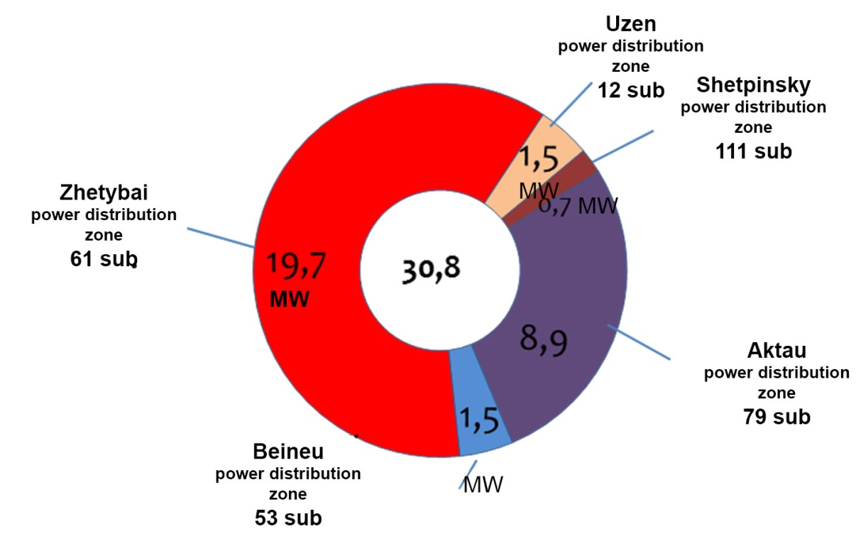
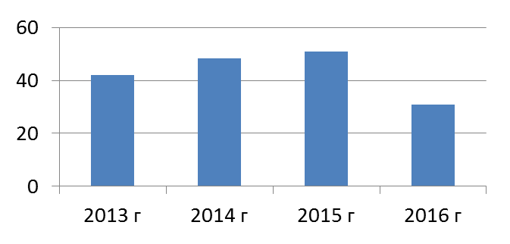
Ongoing work with consumers, including information on the issuance of new capacity
Issued Technical Conditions with breakdown by power knots
In 2016, 37.6 MW of power was transferred through the networks of JSC "MRPGC" to power supply to consumers, of which:
- 30.8 MW issued the technical conditions for electricity supply to newly connected consumers in the amount of 254 pcs .;
- 5.1 MW are matched by the release of additional power for 59 sub-consumers.
Issued Technical conditions over 1 MW:
BuzachiNeft LLP on email. the supply of the oil delivery station and the infrastructure of the Karaturun East and Karaturun Sea fields in the Tupkaragan region - 1.35 MW;
Bitimova R Self-employed entrepreneur for Electricity supply for cottage houses in Akshukur village - 4 MW
National Company Kazakhstan Temir Zholy JSC - "Directorate for the implementation of large projects" on e. the supply of the ferry complex at the port of Kuryk and the operation of universal cargo-passenger ferries - 4.9 MW
Ersai LLP Caspian Shipyard, located near the village of Kuryk - 10 MW Caspian Shipyard, located near the village of Kuryk, 10 MW
The dynamics of the issuance of capacity for specifications 2013—2016.
48,2 MW
51 MW
42,1 MW
30,8 MW

Slide 6
Execution of tariff estimates for 2016
No. | Name of indicators | Unit
 |  |  | 2016
 |  |  | plan | fact
I | Costs of production of goods and provision of services (works), total | thousand KZT | 7 285 370 | 6 681 527 | 92%
1. | Material costs | thousand KZT | 3 218 402 | 2 627 383 | 82%
1.1. | Raw materials and supplies | thousand KZT | 57 765 | 58 228 | 101%
1.1.1. | Safety equipment, protective equipment, total | thousand KZT | 23 805 | 24 048 | 101%
1.1.2. | Maintenance materials, total | thousand KZT | 30 805 | 30 911 | 100%
1.1.3. | Purchased products and semi-finished products, auxiliary materials | thousand KZT | 3 155 | 3 269 | 104%
1.2. | Electricity for household needs | thousand KZT | 29 735 | 31 561 | 106%
1.3. | Fuels and lubricants | thousand KZT | 59 969 | 55 932 | 93%
1.4. | Costs for compensation of normative and technical losses | thousand KZT | 3 070 933 | 2 481 661 | 81%
2. | Depreciation | thousand KZT | 1 445 110 | 1 433 505 | 99%
3. | Repairs | thousand KZT | 515,329 | 489,517 | 95%
 | Including capital repairs that do not lead to an increase in the value of fixed assets | thousand KZT | 515,329 | 489,517 | 95%
3.1. | Repair of fixed assets, total, including | thousand KZT | 321,933 | 305,171 | 95%
3.2. | The cost of materials for repair (economic method), total, including: | thousand KZT | 193,396 | 184,346 | 95%
3.2.1. | The cost of materials for major repairs, total, including: | thousand KZT | 145,024 | 144,092 | 99%
3.2.2. | The cost of materials for current repair, total, including: | thousand KZT | 48 372 | 40 254 | 83%
4. | Labor costs, total, including: | thousand KZT | 1 317 520 | 1 360 527 | 103%
4.1. | Wage | thousand KZT | 1 199 918 | 1 237 765 | 103%
4.2. | Deductions from remuneration (social tax and social insurance) | thousand KZT | 117,602 | 122,763 | 104%
5. | Tax payments | thousand KZT | 1 626 | 1 626 | 100%
6. | Services of third parties of production nature | thousand KZT | 692,745 | 675,637 | 98%
7. | Other costs | thousand KZT | 94 637 | 93 332 | 99%
II | Period expenses, total | thousand KZT | 2 047 290 | 1 399 960 | 68%
8. | General and administrative expenses | thousand KZT | 1 036 398 | 1 038 670 | 100%
8.1. | Remuneration of administrative personnel | thousand KZT | 197,208 | 211,762 | 107%
8.2. | Deductions from wages of administrative personnel | thousand KZT | 34 904 | 23 082 | 66%
8.4. | Depreciation | thousand KZT | 28 199 | 31 899 | 113%
8.5. | Tax payments | thousand KZT | 361,341 | 371,487 | 103%
8.6. | Business trips | thousand KZT | 16 658 | 16 046 | 96%
8.7. | Representation expenses | thousand KZT | 286 | 258 | 90%
8.8. | Communication services | thousand KZT | 9 238 | 9 342 | 101%
8.9. | Payment for consulting, audit and marketing services | thousand KZT | 12 851 | 9 590 | 75%
8.10. | Bank services | thousand KZT | 16 139 | 13 495 | 84%
8.11. | Other expenses | thousand KZT | 359,574 | 351,709 | 98%
8.11.1. | Payment for services of third-party organizations, total | thousand KZT | 71 437 | 65 760 | 92%
8.11.2. | Other expenses of general economic nature: | thousand KZT | 158,379 | 163,040 | 103%
8.11.3. | Electricity metering expenses | thousand KZT | 129,758 | 122,909 | 95%
9. | Interest expense | thousand KZT | 1 010 892 | 361,290 | 36%
III | Total costs | thousand KZT | 9 332 660 | 8 081 487 | 87%
IV | Profit | thousand KZT | 1 301 454 | 2 272 841 | 175%
VI | Total income | thousand KZT | 10 634 114 | 10 354 328 | 97%
VII | Volume of services provided | thousand kW / hour | 2 516 872 | 2 490 395 | 99%
 | The volume of services provided, for legal entities | thousand kW / hour | 2 151 746 | 2 112 095 | 98%
 | The volume of services provided, for physical persons | thousand kW / hour | 54 425 | 54 128 | 99%
 | The volume of services rendered, the state-owned enterprise pre-requesting services for the transmission and distribution of electricity and Elektrzhuyieleri LLP carrying out activities for the supply of individuals (population) | thousand kW / hour | 310,701 | 324,172 | 104%
VIII | Normative losses | % | 8.21 | 6.89 | 84%
 |  | thousand kWh | 225,307 | 184,500 | 82%
 |  | thousand KZT | 3 070 933 | 2 481 661 | 81%
IХ | Average rate |  | 4.23 | 4.16 | 98%
 | Tariff (excluding VAT) for legal entities | tenge-tiyn / kW | 4.45 | 4.45 | 100%
 | Tariff (excluding VAT) for individuals | tenge-tiyn / kW | 2.03 | 2.03 | 100%
 | Tariff (excluding VAT) for the state-owned enterprise providing services for the transmission and distribution of electricity and Elektrzhuyieleri LLP carrying out activities for the supply of individuals (population) | tenge-tiyn / kW | 2.56 | 2.56 | 100%

Slide 7
Main objectives for 2017
Ensuring reliable and uninterrupted power supply to consumers;
Implementation of an approved investment program;
Attraction of financing for implementation of the investment program;
Execution of the approved tariff estimates;
Achievement of approved key performance indicators;
Implementation of measures for creation of safe and healthy working conditions at each workplace, prevention of industrial injuries and occupational diseases.

